Slide 1
[Insert Event Title]
Presented by [Presented by insert presenter name]

Slide 2
What is Share My Lesson?
Online Resource bank for all education professionals
Provided - for free - to all teachers by the American Federation of Teachers
300,000+ Resources K-12
Professional Development, teacher blogs, current event topics are also included
31,000 Common Core Aligned Resources – vetted by teachers
930,000 teacher members across the country

Slide 3
How SML Helps Teachers, Schools & Districts
Everything you need - all grades Pre-k -12, all subjects
Including ELL, CTE and Gifted & Talented
Personal Profiles - pictures, bios, lesson uploading option for every user
My Saved - save all of your lesson plans, use them now or later

Slide 4
How SML Helps Teachers, Schools & Districts
Share with a teacher or parent - email a link or post on Twitter or Facebook
Comments & Ratings – Help a teacher by providing ratings and suggestions for the lesson
PD Credit – Many webinars offer PD Credit
Personal Support & Assistance – help@sharemylesson.com on call 8am – 8pm.

Slide 5
Helpful Resources
New Teachers
Learn how to create a positive learning environment
Get support setting up classroom routines and establishing expectations
Join a professional network of nearly 1 million educators who share best practices and teaching tips
Get tips for how to work successfully with parents

Slide 6
Helpful Resources
Parents
Learn how to create a positive learning environment
Get support setting up classroom routines and establishing expectations
Join a professional network of nearly 1 million educators who share best practices and teaching tips
Get tips for how to work successfully with parents

Slide 7
Other AFT Resources on SML
Innovation Fund Resources
The AFT awarded Innovation Fund grants to local unions that offered solutions to problems with their state's rollout of the Common Core State Standards. Contributors include:
AFT St. Louis
Albuquerque Teachers Federation
Boston Teachers Union
Cleveland Teachers Union
Jefferson County AFT
Quincy Federation of Teachers

Slide 8
Also brought by the AFT
Colorín Colorado
AFT partner for 4 years
Provides info, activities, and advice for educators and Spanish-speaking families of English language learners featured on SML
Major funding comes from the AFT
First Book
AFT partner for 3 years
Provides Title I or Title I eligible schools access to new, free or discounted, high-quality books.
SML has a collection of lesson plans, handouts and classroom materials aligned with books in the First Book Marketplace.

Slide 9
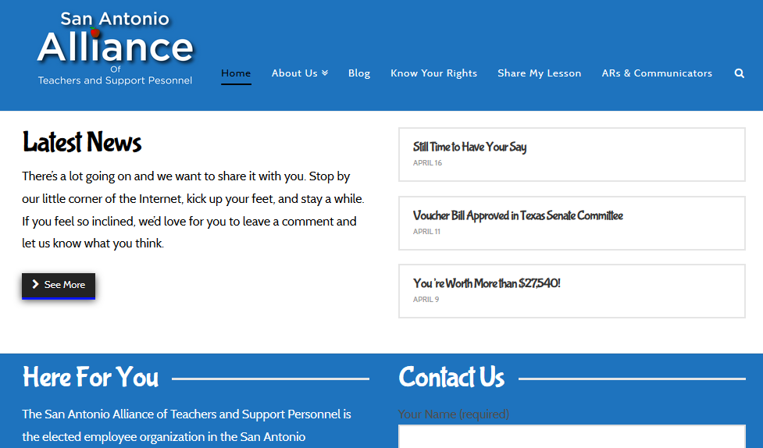
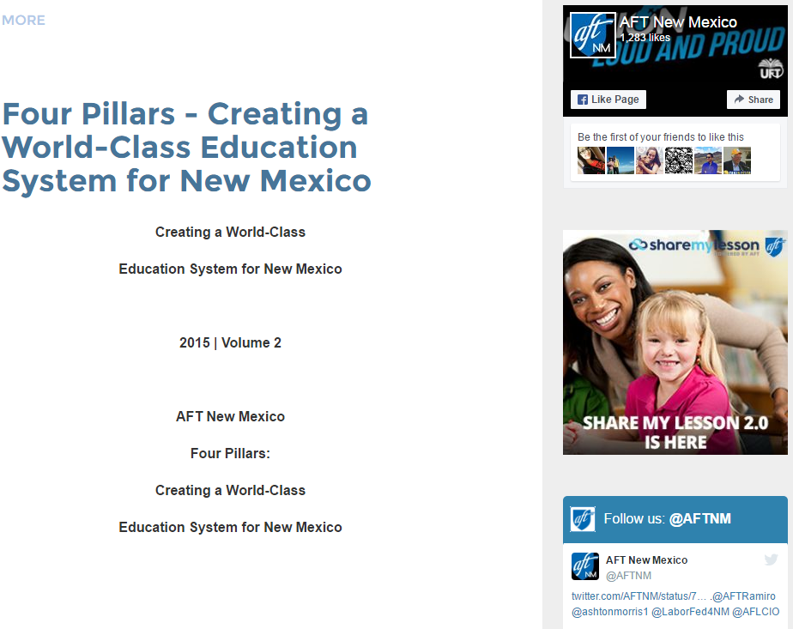
Affiliate Best Practices
Prominent website presence

Slide 10
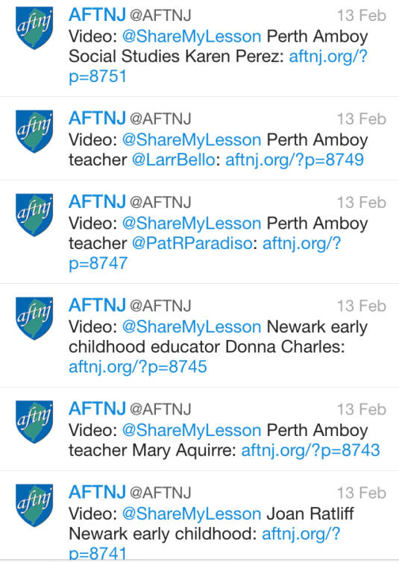
Affiliate Best Practices
Social media engagement

Slide 11
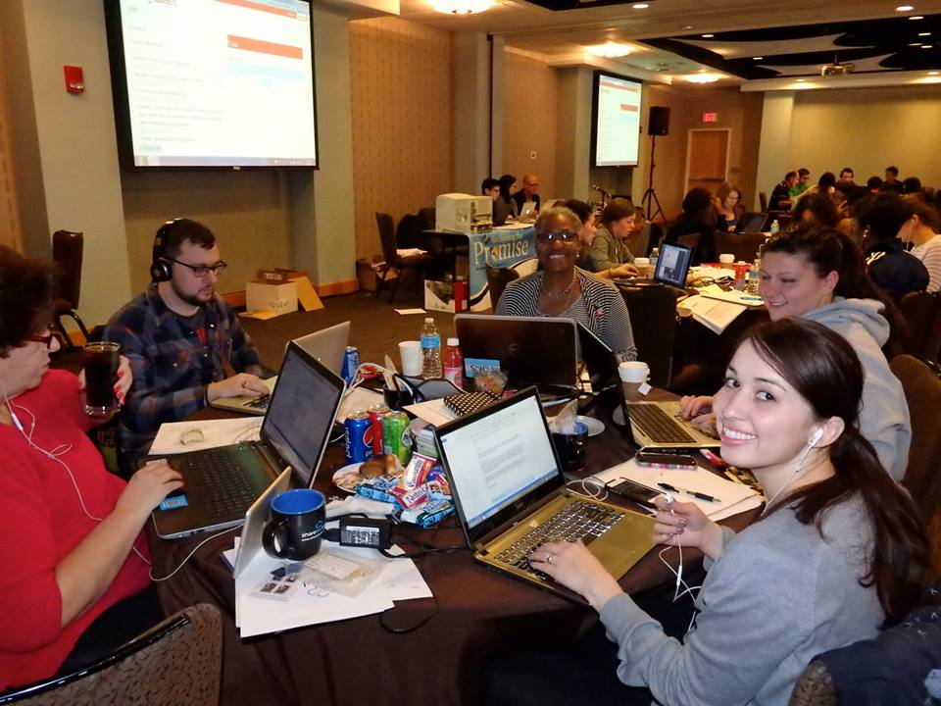
Affiliate Best Practices
Marathon events
50-75 active & retired educators
24-48 hours of collaboration
Hundreds of materials vetted and
uploaded
loaded resources

Slide 12
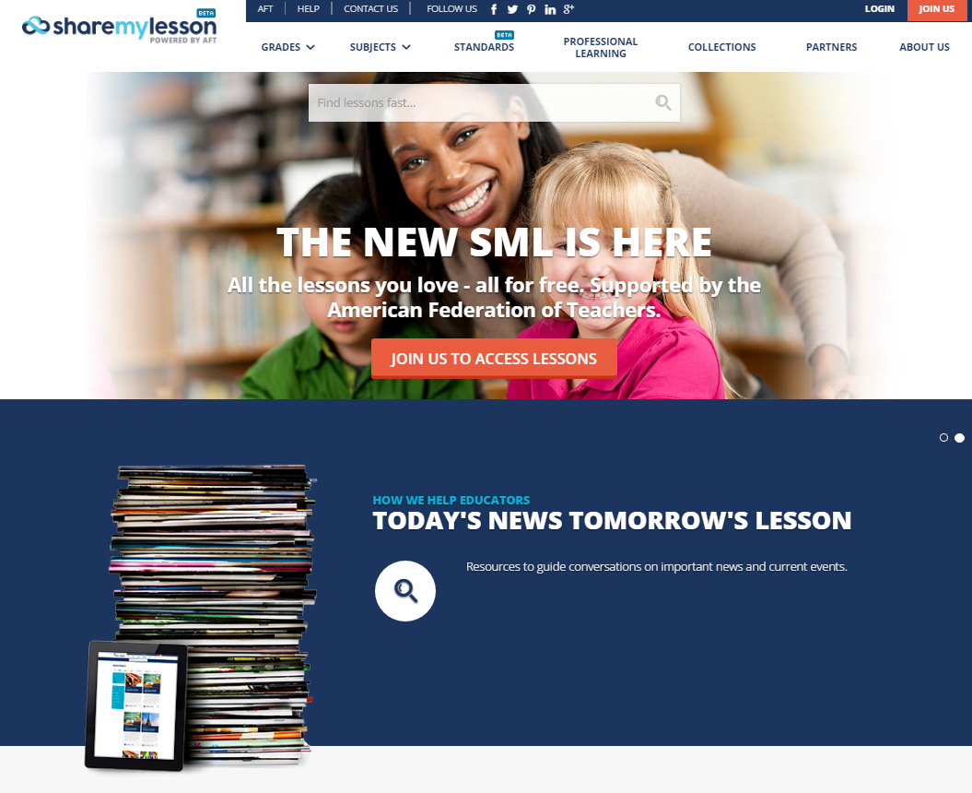
Navigating the Site
www.sharemylesson.com

Slide 13
Questions?
For additional questions, contact:
The SML Team
help@sharemylesson.com

