Slide 1
Student Debt Clinics
Organizing around student debt as a worker’s rights issue

Slide 2
The Issue
Student debt:
is a worker’s issue;
predominately affects workers under the age of 39;
affects all of our members and potential members;
stunts our National economy.
Notes:
Students don’t live with student debt. Payments are due 6 months after graduation.
2/3s of student debt is carried by people under the age of 39.
All constituencies. Parents who co-signed, etc.
Delays large purchases like a home or car.

Slide 3
The Issue by the Numbers
In 2013, the DoE made a profit of $41.3B
40 million+ are indebted to the DoE
1 in 7 went into default w/in 3 years
8.3% were at least 90 days delinquent
1.3 Million enrolled in Income-Driven Repayment despite 33 million being eligible
<300,000 are enrolled in Public Service Loan Forgiveness (PSLF)
Despite ~35 million people working in the public service
Notes:
Out earned every company in the world: ExxonMobile and Apple.
1 in 7: 2012
8.3%: 2013. According to the Federal Reserve bank of NY, people are far more likely to be delinquent on SD than any other type of consumer debt.
IDR programs are intended to provide relief for those who have financial hardship. The programs are meant to prevent delinquencies and defaults. Obviously, the DoE and servicers are prioritizing profit from fees and interest over the interests of borrowers (our members).
Define PSLF. How many of our members are eligible? Nearly all.

Slide 4
Who’s Suffering Most?
Does race impact the likelihood of someone borrowing to attend college?
Yes
No
Don’t know

Slide 5
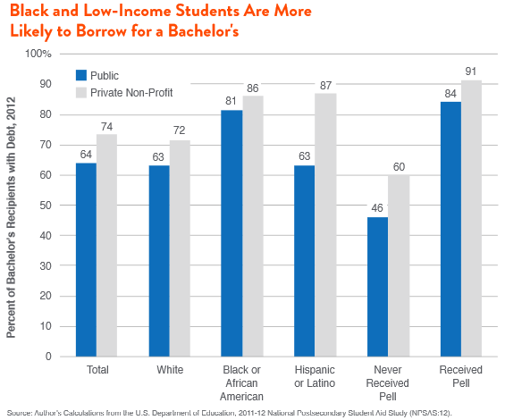
Facts and Figures: Race

Slide 6
Who’s Suffering Most?
Does gender impact how much you borrow and your ability to repay your student loans after you graduate?
Yes – by a lot.
Yes – but only a little.
No.

Slide 7
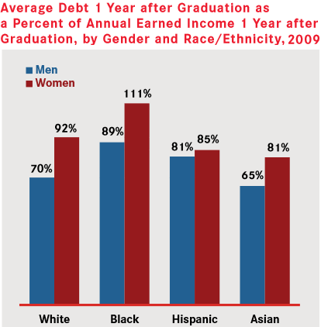
Facts and Figures: Gender
“More women than men, 53 percent compared to 39 percent, are contributing more money to their student debt payments than a typical individual can reasonably afford. This means less money for rent, for health insurance, for groceries. It also means that women in particular will have fewer resources to save for retirement, buying a car, or investing in a home.”
- American Association of University Women, 2012.

Slide 8
Components of the SDC… Before the clinc
1.5 Day train-the-trainer for staff and leadership
Materials for preparation
timeline & tips
branded info materials
sample turnout communications
Resource documents for participants

Slide 9
What’s covered in a SDC?
Facts and figures that expose systemic problems of student debt
Navigating Income-Derived Repayment plans:
Who qualifies?
Benefits of enrolling
How to enroll
Public Service Loan Forgiveness
What it is & who can benefit
Qualifying payment plans
Notes:
This is the Anger portion of the AHUY model
Hope

Slide 10
Using the SDC as an Organizing Tool
Engagement on an issue that transcends constituency, gender, class…
A different point of entry to engaging with the local
Notes:
Urgency

