Slide 1
Recommitment Campaigns
Building the union in a post-Janus reality

Slide 2
Welcome and Introductions
Notes:
5 min
Sarah Derdoski—Organizing Specialist at Education Minnesota
Brian McNamara—Field and Organizing Director, United Teachers of Los Angeles

Slide 3
Session Objectives
Discuss the value of recommitment campaigns for your union
Identify the critical elements of a successful recommitment campaign
Develop a “Janus Checklist” participants can use for planning their recommitment campaign and ongoing organizing work
Notes:
Sarah
5 minutes

Slide 4
Sample Card (which UTLA pretty much copied from BTU)
Notes:
BRIAN:
Card is in folders, we copied BTU
Local law may be different and have different constraints but we do know that the Janus ruling will eliminate fair share and allow employees to cancel dues at anytime.
Based on advice from our attorneys and similar strategies being used by other locals in the room, at UTLA our new cards do 3 things:
People sign up to be a member, which they can cancel at any time
People sign committing to 1) Pay dues, 2) pay dues through payroll deduction 3) continue paying dues unless they revoke their commitment by sending a letter to UTLA during their annual 30 day window period. The drop window allows us to budget appropriately and limits the volatility of membership and creates challenges for drop campaigns organized by outside forces.
People sign up to contribute to PACE- our political action fund
In re-committing to UTLA we are building power in the fight for public education and to improve the jobs and lives of educators.

Slide 5
Why Do a Recommitment Campaign?
Notes:
30 Min (whole section)

Slide 6
Verify Membership
Notes:
Brian
2 min
The easy and most straightforward reason to do a recommitment campaign is to cover your ass. The day may come when every union will need to verify the membership of every member—on that day, we will want those cards.
Those cards will also include the strongest legal language possible to maintain membership, dues, and payroll deduction.
.

Slide 7
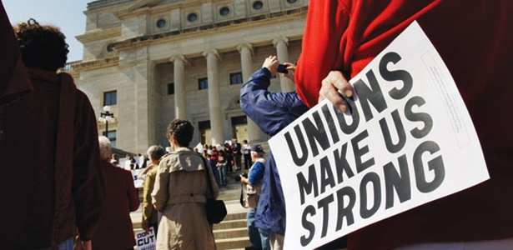
Rethinking and Redefining “Unionism”
What are the values that your union represents?
How do those values manifest in the work the union does?
What does being a member look like? Is it just paying dues?
How do members see themselves reflected in their union?
Notes:
Brian
3 min
The threat of Janus, among others, provide the broader labor movement with the opportunity to rethink and redefine what a union is and does in a right-to-work reality of “voluntary” membership.
Before asking members to recommit to the union, take the time to think about what your union stands for and does—this process will inform the development of your messaging, which we’ll talk about later
Round robin/discussion: how do you think the way you talk to members about your union will change post-Janus? (move to message discussion)

Slide 8
Organizing Opportunity
This isn’t about just asking members to sign a card—this is a chance to educate them an get them more engaged in the union.
Notes:
3 min
Sarah
Opportunity to organize every worksite, opportunity to talk to each member about the attack, the union’s response and the union’s broader campaign for educational and workplace justice

Slide 9
UTLA Schools LA Students Deserve Campaign
Redefining the Union – from service model to organizing model
Chapter Chair Recruitment
Contract Action Team Recruitment
Notes:
900 chapters, 800 worksites
3 + year project
Identifying issues
Training Chapter Chairs in one on ones
Doing thousands of site meetings
Organizing school site actions and city wide actions
Voting to reinvest in the union

Slide 10
The Union is About Power
We have to do 3 fundamental things:
Identify the concrete issues that members and community are willing to fight for.
Call out the enemy – who has the power to give us what we want but is not?
Organize to use collective power.
Notes:
We believe that we have to do three fundamental things:
Identify the concrete issues that members and community are willing to fight for:
Who are the members? Who is the community?
We need structures and systems to talk to all members, not just the ones who are involved in the union.
Call out the enemy – who has the power to give us what we want but is not?
This could be the school board, the county, the state, the republican or democratic party, the privatizers.
Defining narrative. Privatization,
So our targets are the governor and state leaders (almost all democrats) who we need to stop the privatizers (their billionaire contributors) and put more money into public education which they can only get by taxing the rich, who are their donors. We know we have to create a crisis that forces people to take a side.
Organize to use collective power. – Use it
The folder has a copy of our bargaining demands and a framing on California’s budget priorities.

Slide 11
School Site Mapping
Dept.
Dept.
Dept.
Dept.
Dept.
Dept.
Out of Classroom
.
Parent Liaison
CAT:
CAT
CAT:
CAT:
CAT:
CAT:
CAT:
CAT Parent Liason
John Adams
Brian Lane
Alex Greg
Kelly Jones
Nancy Smith
Liz Chapel
Mira Jimenez
Jenn Lee
Sylvia Corria
Hsiang Wong
Larry Vidal
Dan Albert
Monica Blast
Edgar Novak
Karla Dante
Stacey Marin
Ebony Gray
Janet Card
Logan Flora
Luis Flores
Jan Langston
Zayden Noel
Nims James
Mason Dallas
Hank Joseph
Caleb Jeffs
Carmen Bans
Key’Asia Tan
Sophia Grace
Archer Penn
Redd Ans
Jaylanie Kidd
Rosetta Bar
Dean Barnes
Barb Barnett
Beau Craig
Tom Arrow
Chas Romeo
Ann Hershey
Kate Hart
Larry Vidal
Ruby Mast
April Dove
Valentine An
Scarlett Lip
Plum Vance
Jose Marcade
Rhett Herd
Lance Pipp
Paul France
Tony Davis
Dan Darrell
Dante Moor
Byron Dance
Kim Adam
David Axton
Sue Ashford
Ann Chanel
Bill Chamber
Chris Carter
Ted Chapelle
Phil Harper
Moni Hilton
Edgar Park
Karla Knox
Liza Laird
Mia Kipling
Jen Lane
Jon Lennon
Mike Liddell
Howard Pak
Tim Jackson
Kris Hoover
Mason Lane
Ted Price
Bob Barbie
Steve Jans
Andrew Lan
Pat Rosas
John Adams
Brian Lane
Alex Greg
Kelly Jones
Sandy Goby
Fidel Lasos
Andy Chen
John Butcher
Zoe Faith
Notes:
(CLICK) By Department(slide): This is chart is the same with just the column or group headings changed to Department.
There is also a generic version in your folder that you can use if you are mapping your school by another method, such as by social group.

Slide 12
Chapter Chair and CAT recruitment
Chapter Chair Recruitment:
Systematic one on one recommitment conversation
Contract Action Team Recruitment
1 to 10 ratio
Every member covered by department, grade level, or other grouping based on the school site map
Responsible for regular small group and one on one conversations about the contract campaign, school site and other union issues.
Notes:
Brian

Slide 13
Education Minnesota Power of We Overview

Slide 14
A bit of background
2015: Friedrichs v CTA
Launched the Value of Belonging campaign to strengthen our union in the increasingly hostile political climate
Deep, cleansing breaths
2016: Scalia Dies
2017: Janus v AFSCME
Launched the Power of We campaign as an extension of VoB

Slide 15
Guiding Principles
The effort to renew all members must be led and driven by the members at the local level.
Members at the local level will require significant training and ongoing support from the state to achieve the campaign goal.
The campaign must be honest and transparent with members about the renewal process.
Notes:
In April of 2017, the membership passed a business item at the Representative Convention authorizing the Power of We campaign—for us, this is a critical hurdle to overcome before doing much of anything statewide.
The form we are asking members to sign is a binding contract with the union and changes the window during which they can drop their membership.

Slide 16
Important context
Not a right-to-work state
Relatively low percentage of agency fee payers
Service-based model
Never really had to organize members
Notes:
There are only two types of people in each bargaining unit: members and fee payers. If the school district is organized, you are in the union whether you want to be or not. You can choose what you pay—full dues or “fair share” fees. Fee payers receive fewer benefits than members and cannot vote on their contract.
Education Minnesota has never really had a reason to organize members, as they’ve never had a choice about whether to belong. Shifting to a “services plus” model has been one of the greatest challenges for the organization both internally and externally—more on that later.

Slide 17
Why the Power of We campaign?
Dig through mountains of paperwork to find old forms
Ask every member to sign a new form
Provides an opportunity to have relational and focused conversations with members
Notes:
In order to prepare for Janus, national council advised all affiliates to ensure that they had a record of every person’s membership application.
We thought about whether we wanted to spend our time and money going through a mountain of paperwork, or if we wanted to use this as an opportunity to have very focused and meaningful conversations with our members with a very specific ask.
We chose the latter as we had spend considerable time and energy in developing the infrastructure to support the Value of Belonging campaign.

Slide 18
How the two campaigns interact
Value of Belonging
Power of We
Relational organizing campaign to ensure every member sees the value of belonging to their union
Campaign to secure membership renewal forms from every member by May of 2018
1:1 conversations with members about what they value

Slide 19
What it looks like day to day, on the ground
State Assn.
State Assn. Staff
Local Leaders
Develops campaign goals, timeline, and support resources
1:1 conversations with local leaders about the campaign
Ask members to sign form and commit to the union
Governance
Approves the Power of We campaign goals
Notes:
Governance/Members
Approve action item at the RC to recommit all members to the union by April, 2018
State Association
The state level governance develops the overall goals and timeline for the campaign, but leaves the development of strategies and tactics to individual locals
Provides grant funding and all other tools and resources for locals to use
Trains state staff to implement campaign with their assigned locals
Tracks all data collected at the local level and provides reports
Analyzes data on a statewide level to identify trends and inform future program decisions
State Staff
1:1 or regional meetings with local leaders about the campaign—what is it, what is expected of them, how the state will hold locals accountable, the resources available to locals to implement the campaign in a way that is tailored to local needs/issues.
Local Leaders
1:1 conversations
Building blitzes
10-minute meetings or other events
Ask members to sign the form
Ask members to commit to being an active member of the union
Ideally: engage members in conversation about what they value, what issues they care most about (for themselves and their students)
Collect data and share it back with state assn.

Slide 20
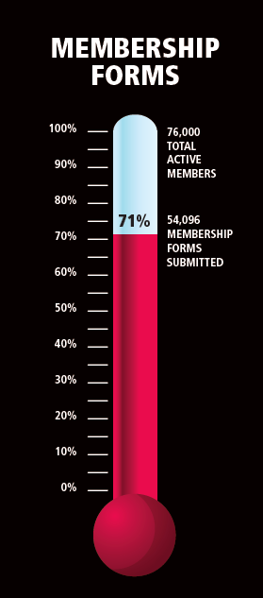
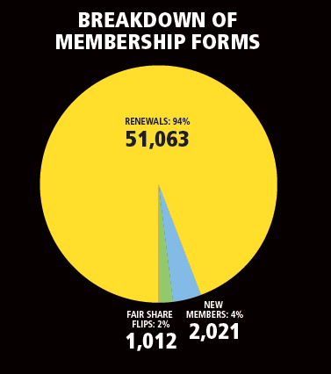
Progress to Date
Notes:
As of January 1, 2018.
In just 4 months, 71% of members have returned a form. Of those, 2,021 are brand new members and just over 1,000 are fair share flips.

Slide 21
What’s Next?
Phase I: Prepare and Experiment
Now-Janus Decision
Power of We membership renewals
Member follow-up and engagement based on interests
Phase II: Adaptation
Janus Decision-September 2018
Retain current members
Phase III: Surviving and Thriving
September 2018 and beyond
Janus rapid response communications and support
Preparing locals for a right to work reality
Tracking member support for the union
Canvasses in buildings and over the summer
Recruit new members
Regain lapsed/lost members
Create members-only local identity
Growing local strength as a voluntary union
Notes:
The Value of Belonging internal committee has developed a strategic plan that includes the PoW effort, and looks forward to the right-to-work reality we will all enter once Janus is decided.
The Value of Belonging internal committee worked with Executive Staff to identify the locals that are trying to do the Power of We but are struggling for some reason. This, combined with other factors, informed a set of “targets” where the state organization will offer additional support and potential intervention to get these members renewed.
Once the PoW is “done” we will continue to work of the Value of Belonging campaign—focusing on building local capacity to engage members in a meaningful and sustainable way, and continuing to shift to a “service plus” model at the organizational level.

Slide 22
Are you doing a recommit campaign?
Notes:
Sarah
10 min
1-2 volunteers: are you currently running a recommitment campaign? If so, tell us about why you decided to do it and how it’s going?
If not, why not?

Slide 23
Critical Elements of a Successful Recommitment Campaign

Slide 24
What Do We Need To Succeed?
Message
Structure and Organization
Local Context
Tools for Leaders
Notes:
2 min
Sarah
Elements of a campaign (review all then discuss each element in detail and note experiences, ideas and strategies for each):
Structure/Organization:
Leadership identification and recruitment
Staff and member leadership development
Communication and organizing structures – Building Reps / leaders, Contract Action Teams, School Site Maps
Systems – lists, assignments, data turnaround, follow up
Local (Local!) context:
Objective conditions on the ground (issues and opportunities at the school site, district, city and state level)
Tools for leaders (discussion and share what we have):
Talking Points
FAQ’s
Lists
Basic lit (enough but not too much!)

Slide 25
Message
The Power of We campaign messaging was developed by:
Polling
Phone surveys
Data gathered from 1:1 conversations with members
Focus groups
Notes:
5 min
Sarah: EDMN Power of We Messaging (handout)
1. Education Minnesota is a voice for professional educators. When educators speak with one, strong voice, every political leader from Aurora to Zumbrota knows where we stand. Without us, they would lose the shared experience, training and expertise of thousands of educators. Imagine if we were silent. It would harm every school, campus and student in Minnesota. 2. Education Minnesota creates better working conditions for educators. Minnesota educators have better pay, pensions and working conditions than educators in many other states. Why? Because previous generations of educators came together and fought for them. Their legacy includes our pensions and the job protections that let us fearlessly advocate for students. 3. Education Minnesota is the best advocate for our profession. Being part of Education Minnesota means you care about improving your practice. Members of our union have access to valuable training for educators, by educators. We help our colleagues maintain our licenses and grow as professionals. And we are there in the tough times, because anyone can have a bad day and need someone to lean on. 4. Education Minnesota is a champion for our students, communities and families. Organized educators in Minnesota have stood for civil rights for more than 150 years. It’s true. Educators voted for equal pay for equal work at one of our very first meetings in 1862. The structure of our union has changed since then, but we’re still pushing for a better Minnesota. We’re still fighting the racism, discrimination and poverty that holds back too many of our students. There will be educators who don’t see the connection between these old fights and high ideals and the work they do every day. That is understandable. I didn’t see the links when I was starting out, but they are definitely there for anyone willing to look. I hope that in the next few months our conversations will show the Power of We in making progress on both the big issues and the everyday challenges in our districts. Standing together will help us both spread social justice and win everyday improvements in our districts - like useful professional development, carving out a few more minutes to plan a good lesson and building the working conditions that allow us to create more of those “aha!” moments we all work for.

Slide 26
Brainstorm Discussion of Message
What will be the important messages as we go into Janus?
Messages about what the union is/does
Messages to respond to anti-union narratives
Messages to retain current members, to gain new members, to regain lost members
What else?
What messages are working for you?
Notes:
What will be important messages as we go in to Janus?
Flip chart different messages
What’s working for you?

Slide 27
Structure and Organization
Notes:
15 min
Brian
Discussion of best practices

Slide 28
Local Context
Notes:
3 min
Brian
Brainstorm discussion
Examples for UTLA: we are in bargaining for our contract and benefits—so Janus is wrapped up very closely with issues people care about. The ratification vote of the contract is a local context/opportunity.

Slide 29
Tools and Support for Local Leaders
Power of We Toolkit
Introduction letter from President Denise Specht
Talking points for the Power of We campaign
Sample conversation guide (graphic)
Membership Renewal form instructions
Online Renewal instructions
Information about available grants and grant application
Testimonial videos to share with members
Notes:
Example: Power of We Toolkit
Copies of all of the Power of We toolkit materials are included in the folders provided to participants.
Links to video testimonals:
https://www.youtube.com/watch?v=pgmACrcVTqU&feature=youtu.be
https://www.youtube.com/watch?v=Jud0g5lCTTk&feature=youtu.be
https://www.facebook.com/RBReich/videos/1189540404391887/

Slide 30
Preparing for Janus: Sharing What We Learned Today
Notes:
Commitment to sending out notes from today’s session.
Discussion—what else should we think about?

Slide 31
Wrap Up
Notes:
5 min

